Slide 1



Machine Learning Based ESports Winner Prediction
ShanghaiTech CS181 Project
邬一闻/连奕航/熊昕洋/吕钧霆/余诗博

Slide 2


01
Motivation
When watching esports matches,
did you notice this?

Slide 3
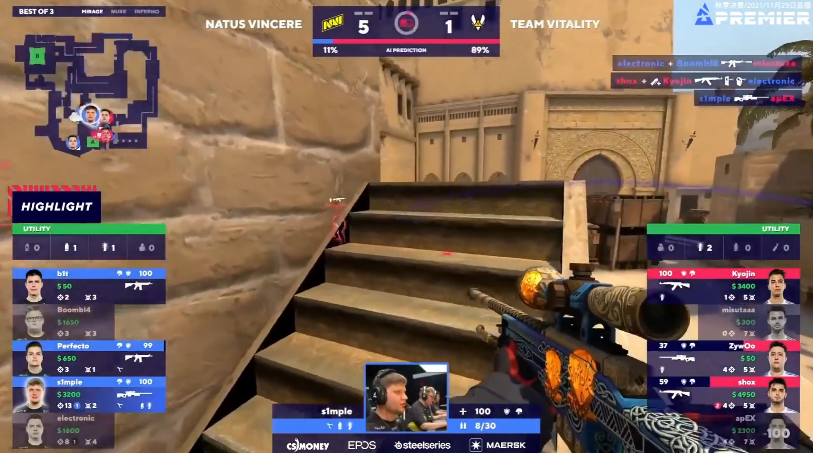
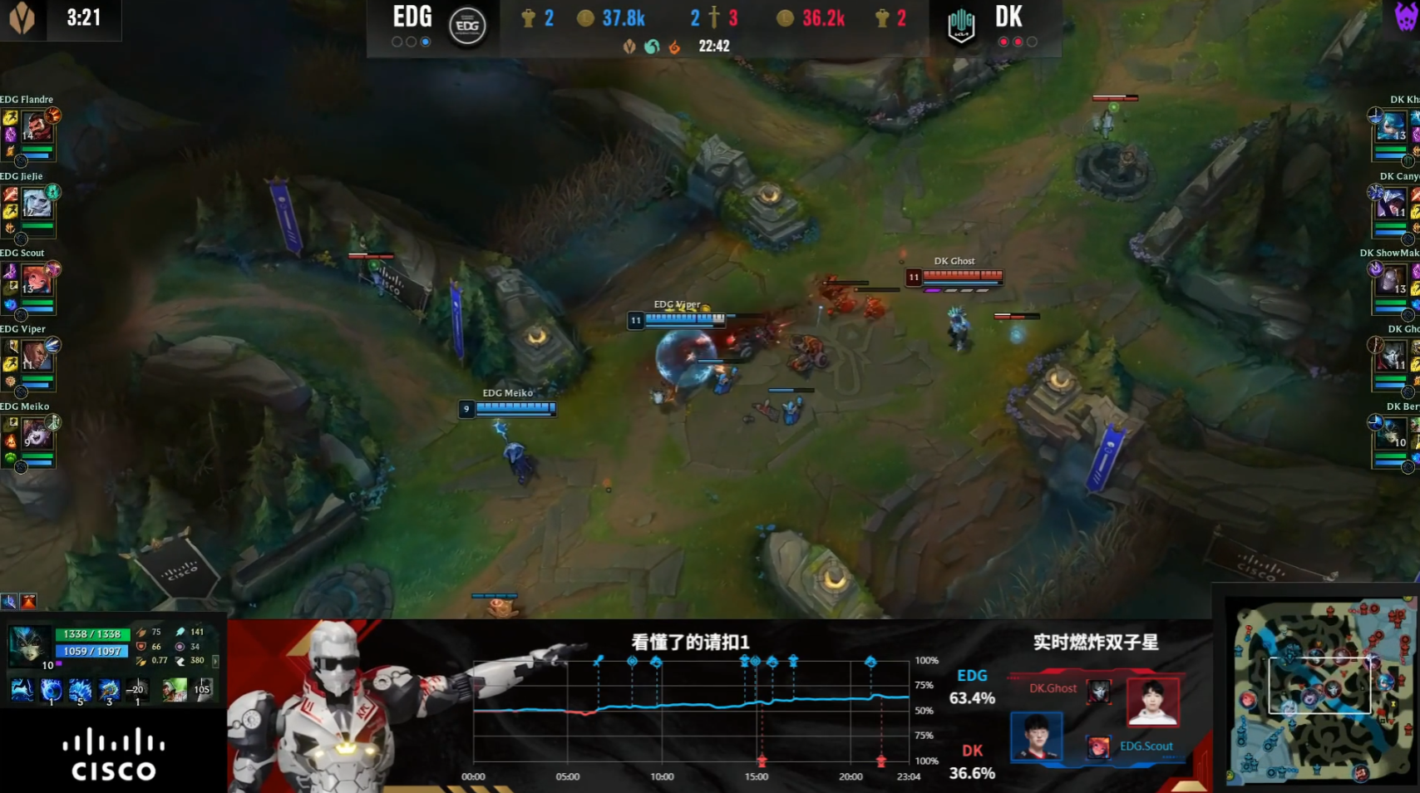
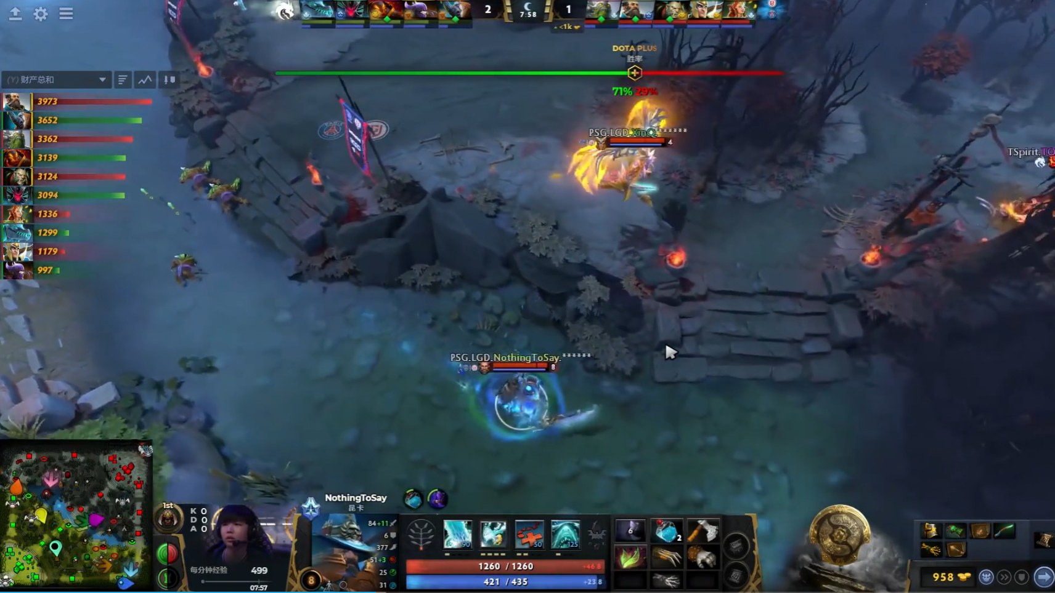
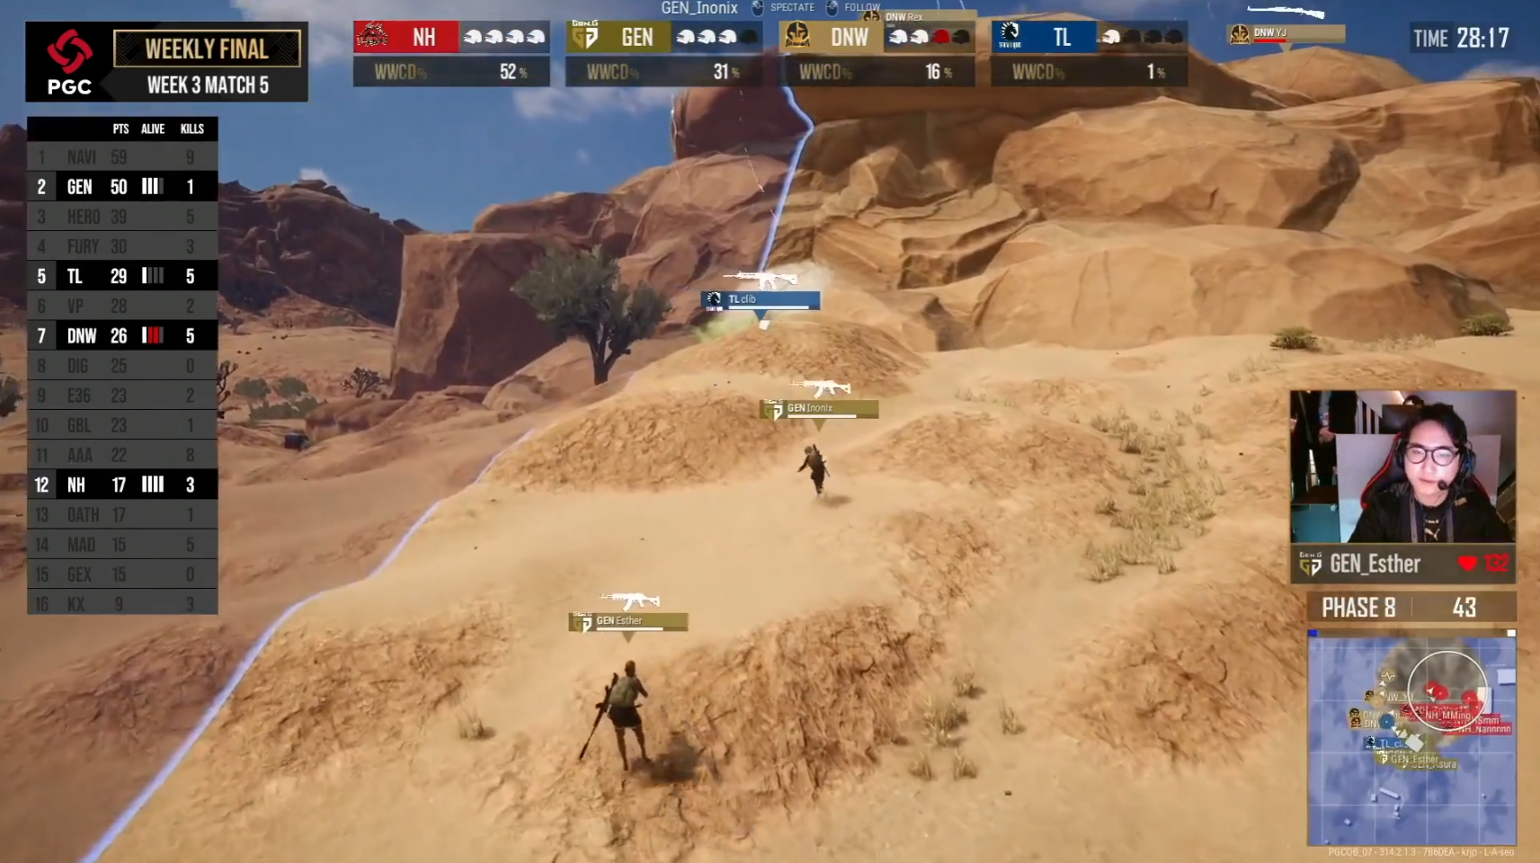
CSGO
LOL
BLAST Premier: Fall Finals 2021
S11 World Championship
DOTA2
PUBG
The International 10
Global Championship 2021

Slide 4
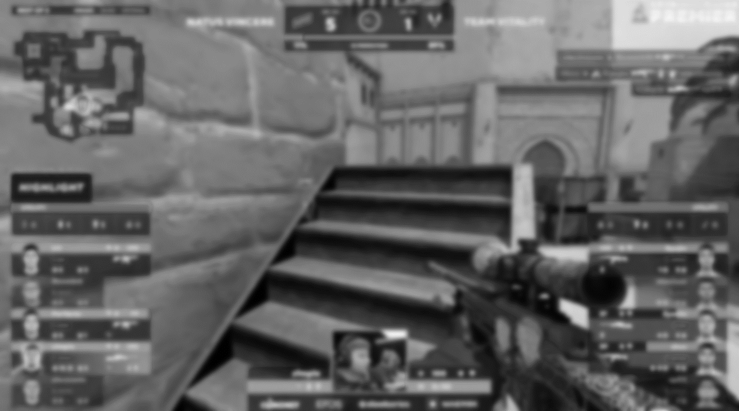
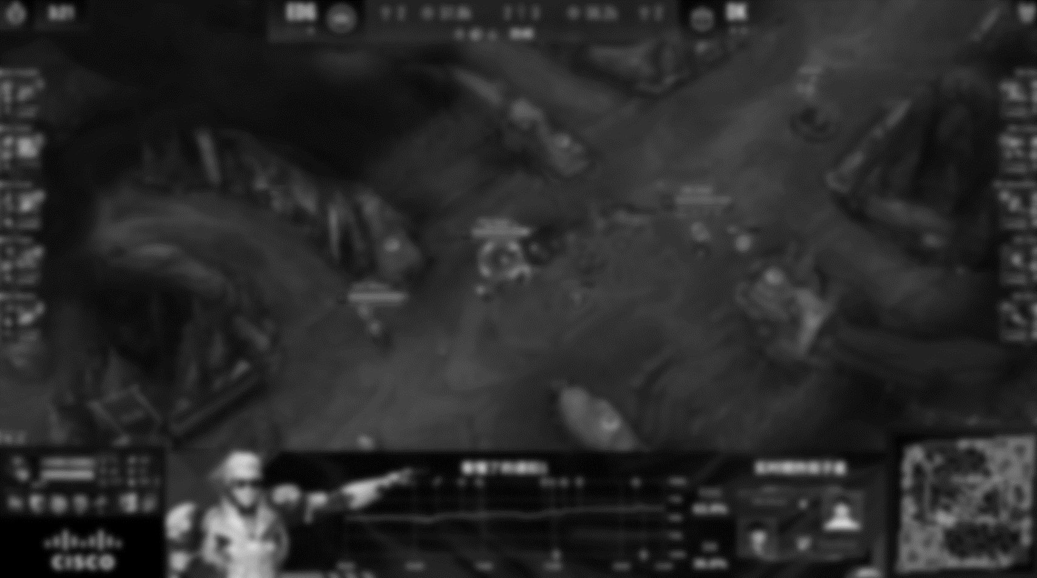
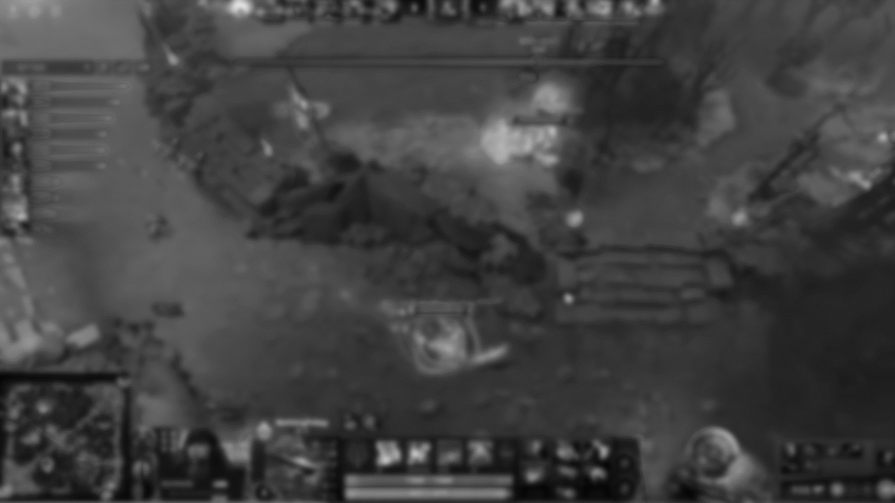
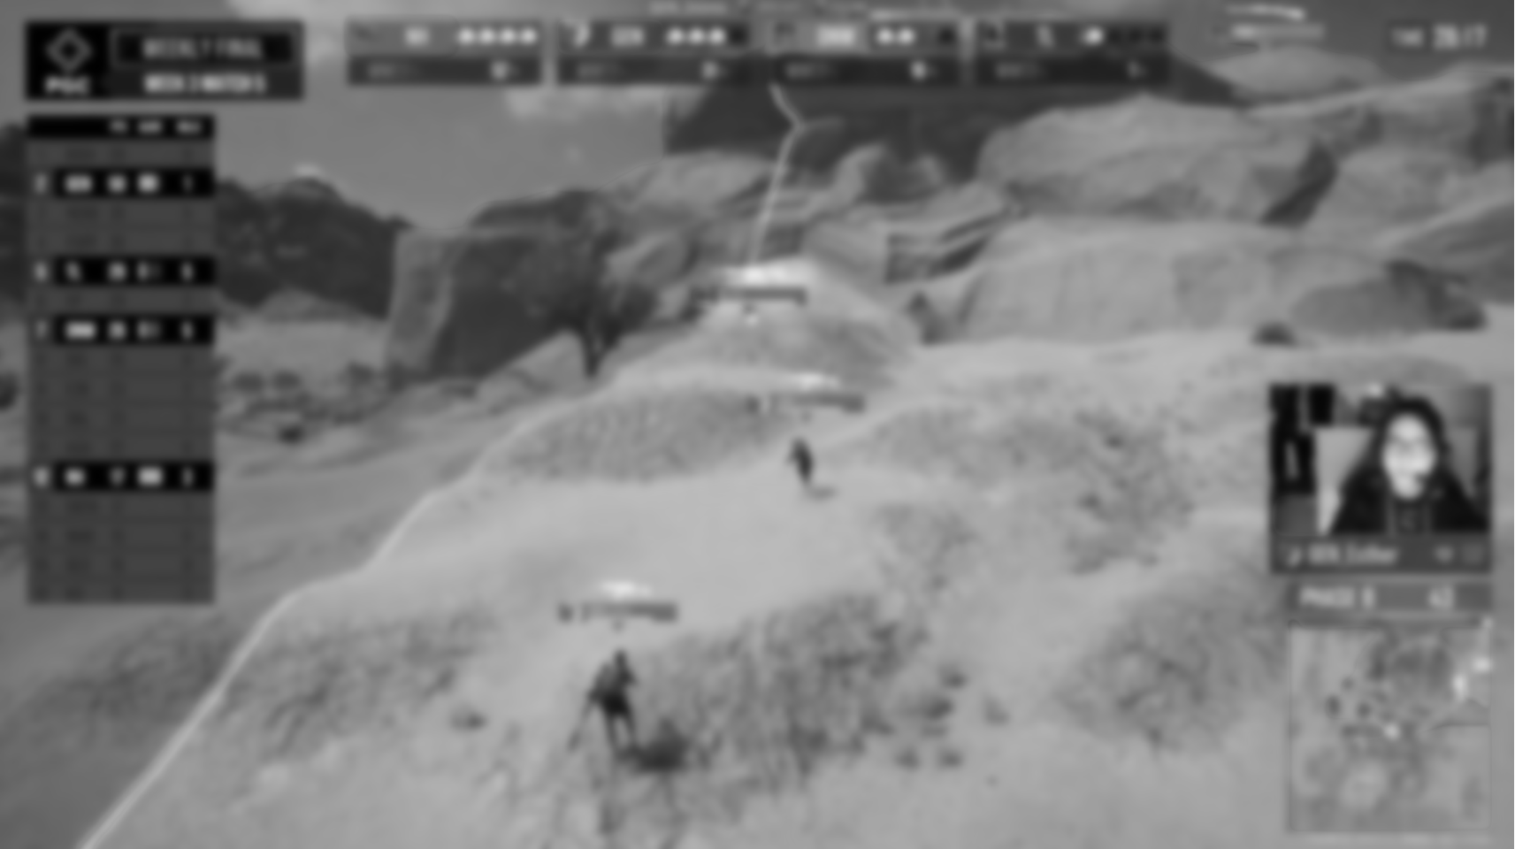
CSGO
LOL
Round Winner Prediction
KI Colonel (KFC-AI) Win Rate
DOTA2
PUBG
DOTA PLUS Win Rate
Chicken Dinner Prediction

Slide 5
Motivations
This work may…
Decide better game lineup
“the meta of current game patch” 版本答案
Help improve pro player’s match win rate
Focus on factors those greatly affect win rate
Predict winner for bet industry
Bet Is BAD but making money!

Slide 6


02
Possible Methods
How can we determine who can win the game?

Slide 7
WHO WILL WIN THE GAME?
?

Slide 8
WHO WILL WIN THE GAME?
MATCH BAN&PICK
TEAM
STRENGTH
IN-GAME
PERFORMANCE

Slide 9
Supervised Machine Learning Approach
TEAM
STRENGTH
MATCH BAN&PICK
IN-GAME
PERFORMANCE
0
1
1
0
f( , , ) = ( ) or ( )

Slide 10
Supervised Machine Learning Approach
TEAM
STRENGTH
MATCH BAN&PICK
IN-GAME
PERFORMANCE
0
1
1
0
f( , , ) = ( ) or ( )
ENCODING
CLASSIFICATION
Extract feature vector
from current game state
dimensions of vector
= # of players

Slide 11

Dataset for LOL Winner Prediction
It is possible to generate self-designed dataset from
Online database
can acquire using web spider
e.g. Liquipedia liquipedia.net/leagueoflegends
APIs
directly request data
e.g. Riot Official API/Leaguepedia API
Public Dataset
Oracleselixir kaggle.com/fernandorubiogarcia/2020-league-of-legends-competitive-games

Slide 12

Feature Encoding for LOL Winner Prediction
Which factors matter to winning the match?
Pre-match:
Team comprehensive strength (global ranking, avg win-rate)
Game patch released by Riot Company
Ban&Pick phase:
Champion BP & Lineup
Player-champion historic win-rate
In-game:
Gold/EXP difference
Player K/D/A
Tower/Dragon/Baron
(Feature Vector)

Slide 13

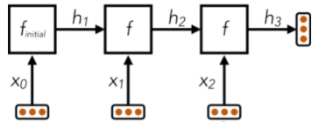
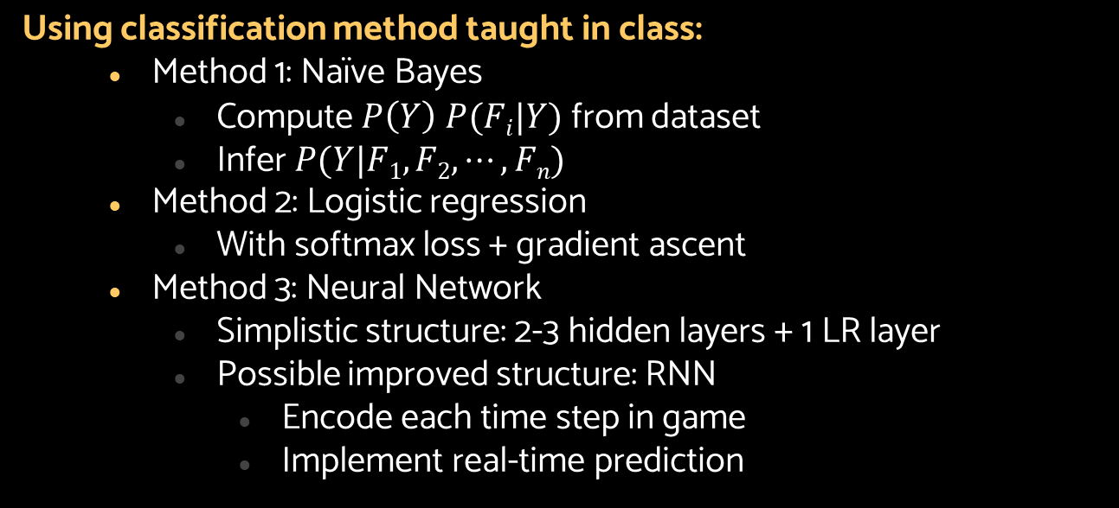
Classification Method for LOL Winner Prediction
Using classification method taught in class:
Method 1: Naïve Bayes
Compute $P\left(Y\right) P(Fi|Y)$ from dataset
Infer $P(Y|F1,F2,⋯,Fn)$
Method 2: Logistic regression
With softmax loss + gradient ascent
Method 3: Neural Network
Simplistic structure: 2-3 hidden layers + 1 LR layer
Possible improved structure: RNN
Encode each time step in game
Implement real-time prediction

Slide 14

THANKS!
Please keep this slide for attribution

